Slide 1


Mastering Real Estate Pricing Through Exploratory Data Analysis
Navigating the complex real estate market requires a deep understanding of the factors that drive home prices. Exploratory Data Analysis (EDA) is a powerful tool that can uncover valuable insights and inform strategic pricing decisions. By leveraging data, visualization, and statistical techniques, data analysts and real estate professionals can gain a comprehensive understanding of the market, enabling them to make more informed and profitable investments.
Dc
by Deepu chopra

Slide 2
Feature Engineering and Size Impact
Feature Engineering
Size Impact
The first step in EDA for real estate pricing is to engineer new features that capture relevant information about the properties. This may include calculating the price per square foot, the age of the property, or the ratio of bedrooms to bathrooms. These engineered features can provide valuable insights into how different property characteristics influence the overall valuation.
Visualizing the relationship between key features, such as bedrooms, bathrooms, and square footage, with house prices can reveal the impact of size on valuation. By analyzing these trends, data analysts can determine which property attributes have the greatest influence on price, informing pricing strategies and marketing efforts.

Slide 3
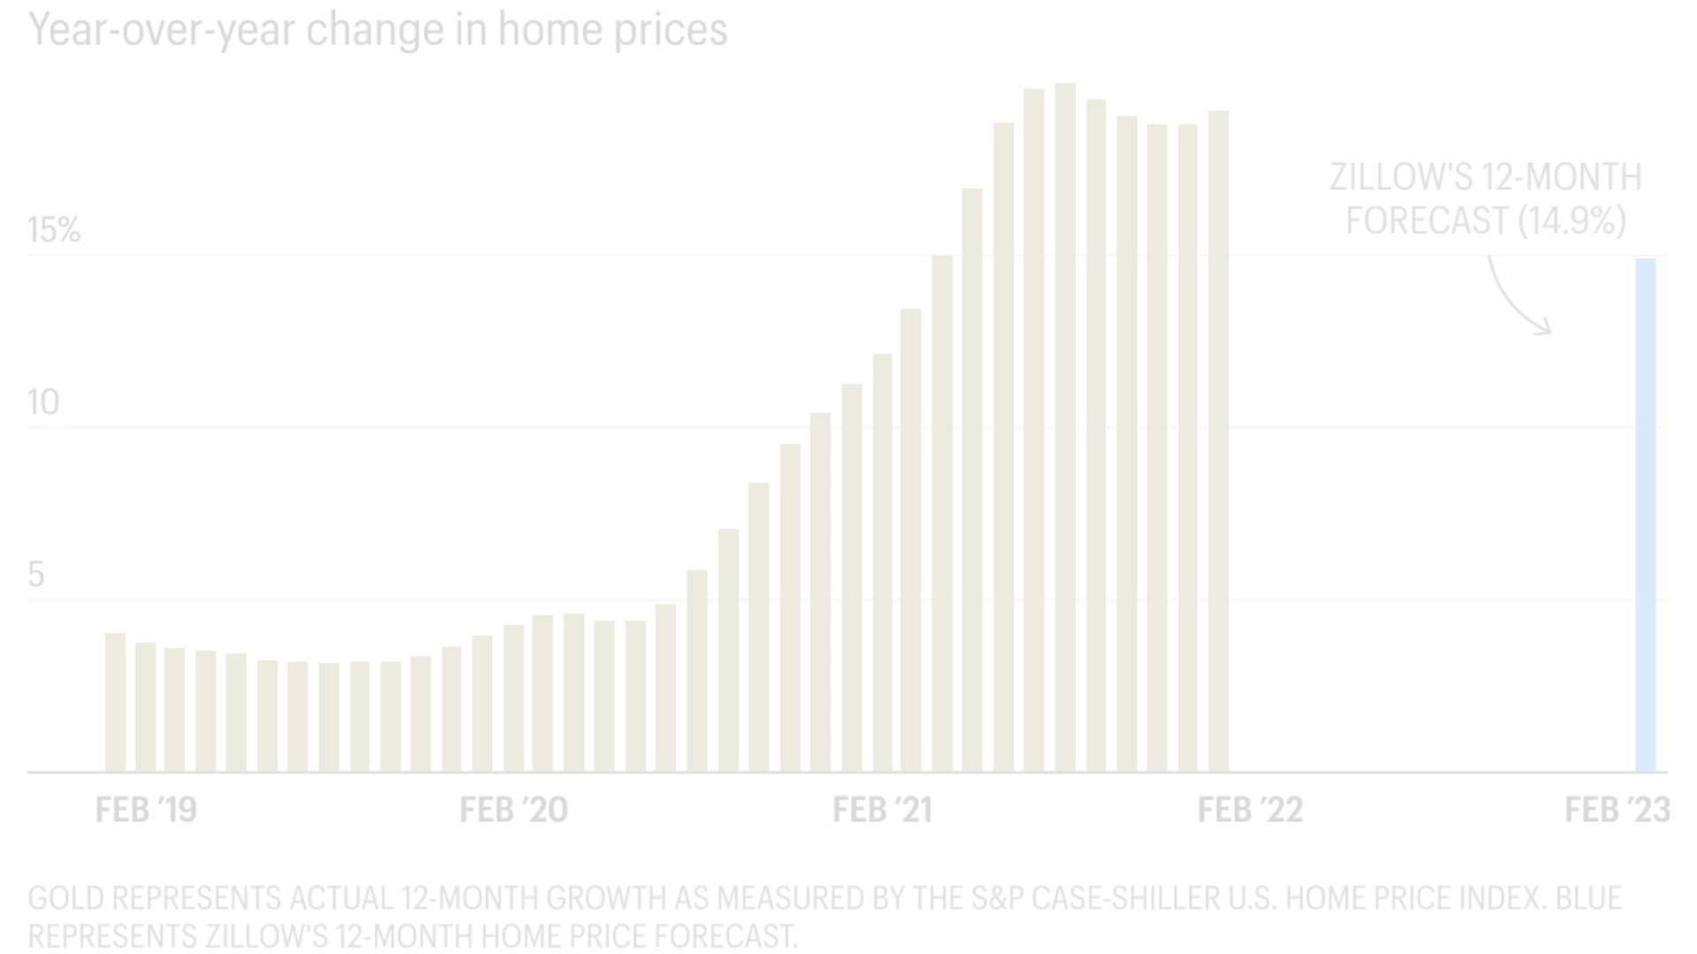
Market Trends and Historical Pricing
Historical Pricing Trends
1
Analyzing historical pricing data over time is crucial for understanding market trends and their impact on real estate valuations. By considering external factors, such as economic indicators, data analysts can identify patterns and cycles that influence the ebb and flow of house prices, helping them predict future market conditions and pricing strategies.
2
Time-Series Analysis
Creating time-series visualizations, such as line charts or heat maps, can provide a clear picture of how market trends have evolved over time. These visualizations can reveal seasonal fluctuations, long-term growth patterns, and other insights that can inform pricing decisions and investment strategies.
Predictive Modeling
3
Leveraging the insights gained from historical pricing analysis, data analysts can develop predictive models to forecast future market trends and house prices. These models can help real estate professionals make more informed decisions, identify undervalued properties, and stay ahead of the competition.

Slide 4

Customer Preferences and Amenities
Customer Preferences
Amenity Clustering
Understanding customer preferences is crucial for pricing real estate effectively. EDA can help data analysts explore the influence of various amenities and features on house prices, such as the number of bedrooms, proximity to schools, or the presence of a pool. By analyzing customer feedback and sentiment, analysts can gauge the perceived value of these features and adjust pricing strategies accordingly.
Applying clustering algorithms to group houses with similar amenity profiles can reveal distinct market segments and pricing strategies. By identifying these clusters, data analysts can better understand the preferences of different customer groups and tailor their pricing and marketing efforts to meet their specific needs.
Pricing Optimization
Integrating insights from customer preferences and amenity analysis can help real estate professionals optimize their pricing strategies. By understanding the value that different features and amenities hold for customers, they can adjust prices to match the market's willingness to pay, ultimately maximizing their return on investment.

Slide 5
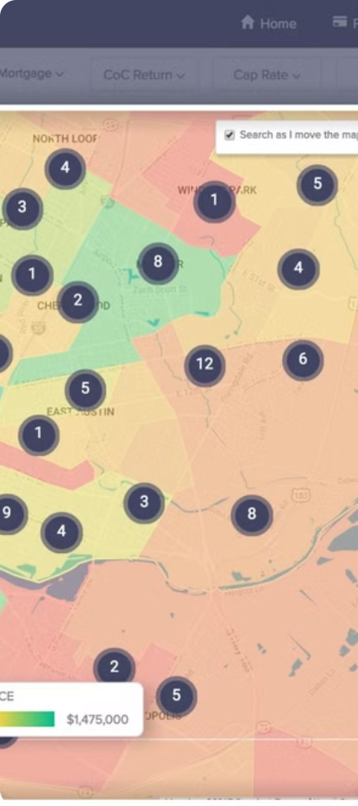
Spatial Analysis and Geographic Factors
1
Location, Location, Location
2
Spatial Visualization
The geographic location of a property is a crucial factor in determining its value. EDA can help identify patterns and trends in how location influences pricing, such as the impact of proximity to key amenities, transportation hubs, or desirable neighborhoods.
Visualizing property data on a map can reveal important spatial relationships and patterns that may not be apparent in tabular data. Heat maps, choropleth maps, and other spatial visualizations can highlight high-value areas, pricing gradients, and other geographic factors that impact real estate valuations.
3
Market Segmentation
By combining spatial analysis with other EDA techniques, such as clustering, data analysts can identify distinct market segments based on geographic factors. This can inform targeted marketing strategies, pricing decisions, and investment opportunities in different neighborhoods or regions.

Slide 6



Incorporating Economic Indicators
Interest Rates
Unemployment Rates
Consumer Confidence
Changes in interest rates can have a significant impact on real estate prices, as they affect the affordability and demand for homes. EDA can help analyze the relationship between interest rate fluctuations and housing prices, informing pricing strategies and investment decisions.
The employment status of potential homebuyers is another crucial economic indicator that can influence real estate prices. EDA can explore the correlation between unemployment rates and housing demand, enabling data analysts to anticipate market shifts and adjust pricing accordingly.
Consumer confidence is a leading indicator of economic health and can have a direct impact on real estate demand and pricing. By analyzing the relationship between consumer sentiment and housing prices, data analysts can better understand the psychology of the market and make more informed pricing decisions.

Slide 7




Predictive Modeling and Pricing Strategies
Data Gathering
Feature Engineering
Model Training
Pricing Strategies
The first step in developing predictive models for real estate pricing is to gather comprehensive data on property attributes, market trends, and economic indicators.
Advanced machine learning algorithms can be trained on the prepared dataset to develop predictive models that forecast future house prices.
The insights and predictions generated by these models can then inform dynamic pricing strategies that optimize real estate investments and listings.
Engineered features that capture the key drivers of real estate valuations are essential for building accurate predictive models.

Slide 8
Communicating Insights and Driving Action
Data Visualization
Effective data visualization is key for communicating the findings of your EDA to stakeholders, enabling them to quickly grasp the insights and make informed decisions.
Storytelling
Crafting a compelling narrative around the data can help stakeholders connect with the insights and understand their real-world implications for the real estate market.
Actionable Recommendations
Translating the EDA findings into actionable recommendations, such as pricing strategies, investment opportunities, or marketing tactics, can drive tangible business value for real estate professionals.

